Slide 1
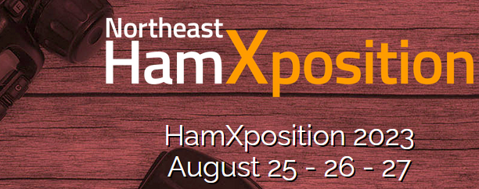
ÄRTEN™ project
www.w1sye.org
Amateur Radio Training Experiment Network
Experiments in the Ham bands from ≈1 to 10 GHz (3 to 33 cm)
Speaker: K1YBE, Paul Fredette, MSEE
For the Newport County Radio Club (w1sye.org)

Slide 2
ÄRTEN™ project
www.w1sye.org
Amateur Radio Training Experiment Network
Experiments in the Ham bands from ≈1 to 10 GHz (3 to 33 cm)
I think of the SHF bands as the new “short wave radio” of this century,
HF(10m to 100m) was considered short wave when Ham radio was established
Now it’s time for 3 cm/10 GHz to 30 cm/1 GHz to be a learning catalyst
============================
This project includes the use of the AREDN Mesh software
An ARRL Foundation Grant of $7,975 was awarded in Dec 2022

Slide 3
ÄRTEN™ - Idea for the name
arten v. (Latin)
To compel, force, or induce (sb. to do sth.);
to induce or bring about (a result);
ärten n. (Swedish) - definite singular of ärt
The Ä umlaut (dots) is intended to represent a charge dipole radiating knowledge.
TEN - A nod to 10 GHz

Slide 4
cm Bands available to all classes of Amateur Licensees
33 Centimeters (902-928 MHz) 13 inches
23 Centimeters (1240-1300 MHz) 9 inches
13 Centimeters (2300-2310 and 2390-2450 MHz) 5 inches
9 Centimeters (3300-3500 MHz) 3.5 inches
5 Centimeters (5650.0-5925.0 MHz) 2 inches
3 Centimeters (10000.000-10500.000 MHz ) 1.2 inches
Already established technology allows us to put them to use in novel ways
We have these radios in our homes now in low cost WiFi routers at 2.4 and 5 GHz.
WiFi frequencies can reuse the many AREDN™ equipment solutions
USE IT OR LOSE IT - continuing pressure on the FCC to reallocate spectrum

Slide 5
Channel Allocations
Unshared 10 MHz channel

Slide 6
CONCEPTS
NCRC will plan and own an array of local mesh nodes and encourage attachment by Hams with an entry level Technician and higher class licenses.
Traffic will be open using published protocols and not encrypted except in emergencies.
TLS and other encryption protocols will be monitored and blocked in normal use.
This makes ÄRTEN an experiment in cybersecurity.
Internet connections are allowed but traffic will be monitored to avoid commercial use.
Low Cost for personal equipment will encourage youth access
Many of the components are available for less than $50 and a station can be <$100.
Most of this can be done with reprogrammed WiFi routers and home brew antennas,
The size of cm band antennas make 3D printing them a reality.
Make the learning material (youtubes and online documents) available for all.

Slide 7
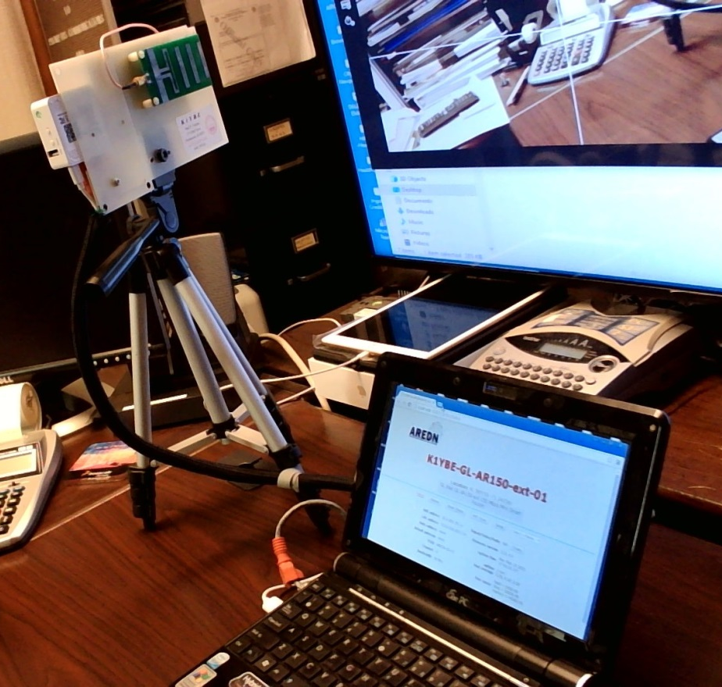
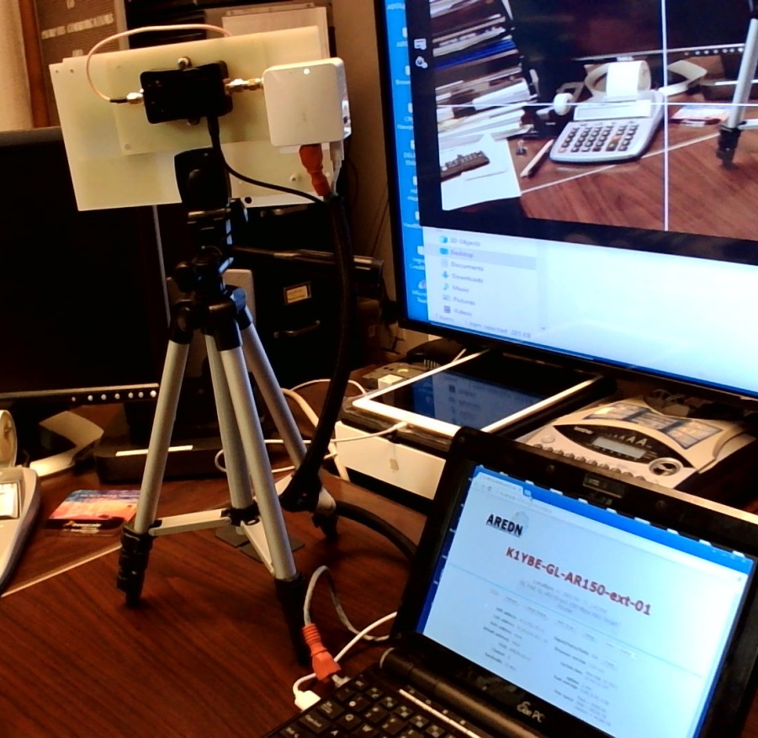
AN EXAMPLE NODE OPERATED AT 3 MILES
Equipment:
Approx. $70
Plus a computer (Raspberry PI is
adequate)
< Yagi-Uda side
Router/Radio(white) >
4 W Amp (black)
Control Web page from the router
↓

Slide 8
Current 2023 Initiatives
Access to a quality 6GHz VNA and training for RF component and antenna calibration
Workforce training for RF/ wireless / xG-NR deployments (see next slide)
Incremental exposure to radio and antenna measurement technologies.
https://nediv.arrl.org/2023/02/17/ham-radio-is-a-gateway-to-technology/
Q. When was the first time you saw and then used a VNA?
CO₂ Sensors in farm fields to collect data that illustrates the Oxygen/CO₂ life cycle.
Weather and solar irradiance data will also be collected to help understanding of the measurements
APRS reporting of CO₂ concentration will be prototyped.
Data will be provided to local Middle and High schools for classroom project analysis.
Exposure to Networking
Mesh nodes allow any IP application to be used. Nodes provide complex functions like Remote Radio control as well as simple MESHCHAT
Advanced monitoring of mesh traffic can be used to demonstrate and implement cyber security techniques
QSOs by chat messaging would use CW procedures to teach these messaging skills.
Radio fun
While Mesh radio at 2397 MHz is the initial deployment for sensor data transmission, the equipment can be use to connect with nodes being deployed in many Mesh projects including the NE Mesh initiative making . CQ MESH and POTA are near term realities

Slide 9
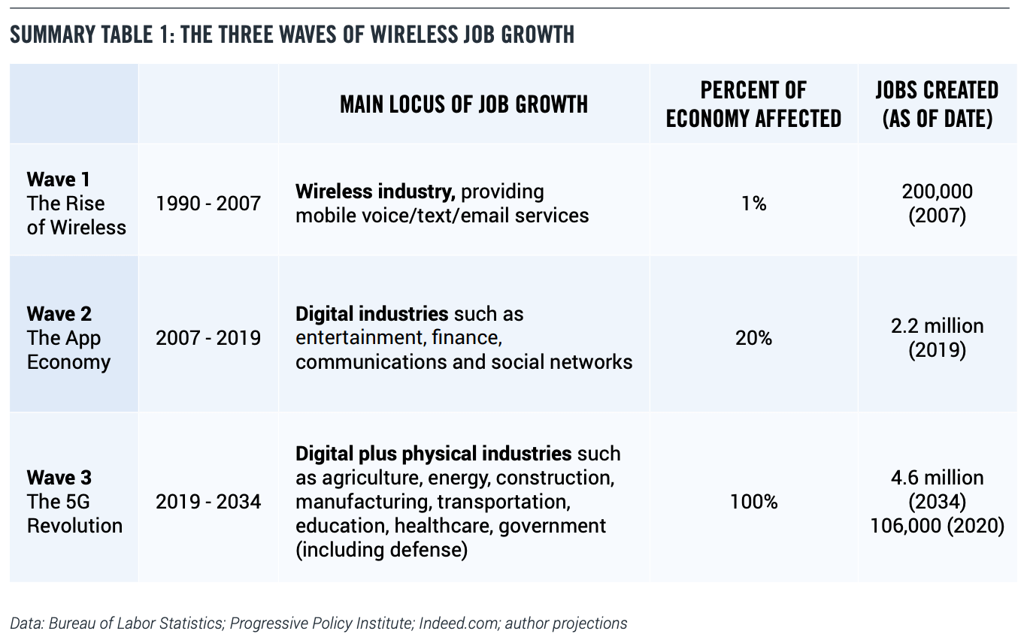
Projected Job Growth - 5G

Slide 10
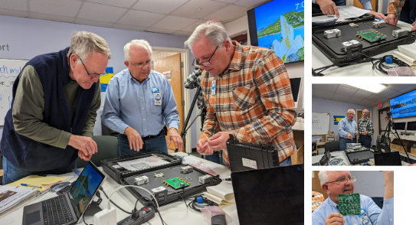
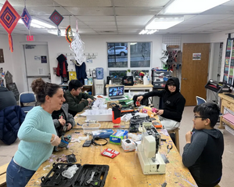
Very Nice Analyzer Initiatives
A quality two port 6GHz VNA was procured and 3 events at Fab Newport held.
Biweekly meeting at FabNewport from 3 to 5 pm engages youth using the center ‘s concurrent STEM activities. Visitors encouraged to attend.
Coupled with:
https://fabnewport.org/pull-it-apart/
ARRL recognition
https://nediv.arrl.org/2023/02/17/ham-radio-is-a-gateway-to-technology/

Slide 11
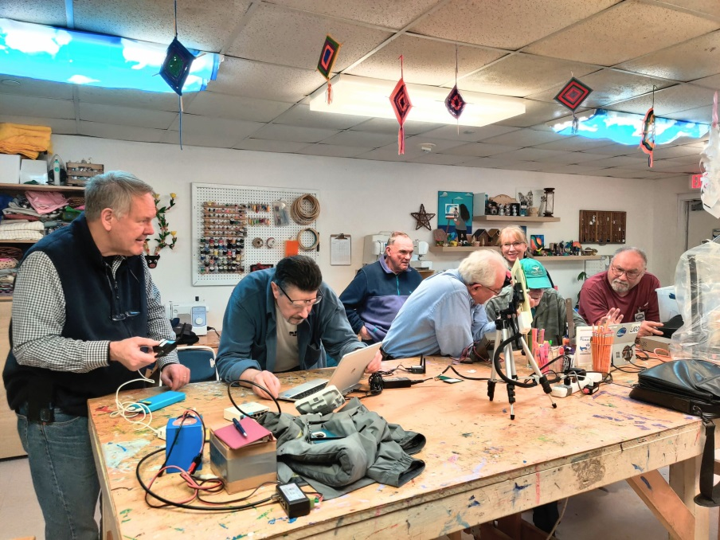
MESHING Around: ÄRTEN Workshops Continue
Posted at W1SYE.ORG on March 23, 2023 by Rob
The ÄRTEN™ project demonstrated a five (5) node MESH network at the March 20, 2023 FabNewport workshop.
The network consisted of: a range-extended GL.iNet AR150-Ext node (on tripod); a regular GL.iNet AR150-Ext; two GL.iNet AR300M16-Ext; and a Microtik SXTSQ Lite 2.
In addition, K1YBE demonstrated collecting CO₂ measurements with two Vaisala GMP343 probes.
ÄRTEN™ Project goals were reviewed and a way forward using an Ethernet-enabled CO₂ sensor was approved. A lively discussion on environmental monitoring in general and CO₂ monitoring in specific ensued.

Slide 12
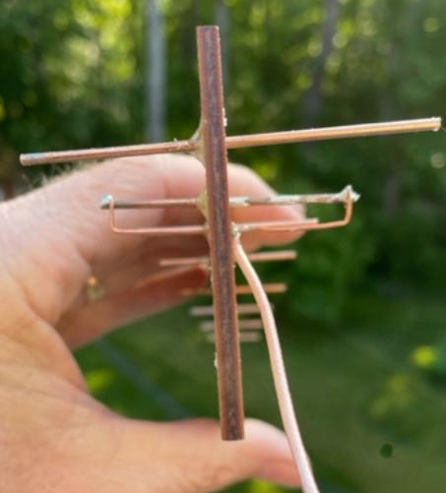
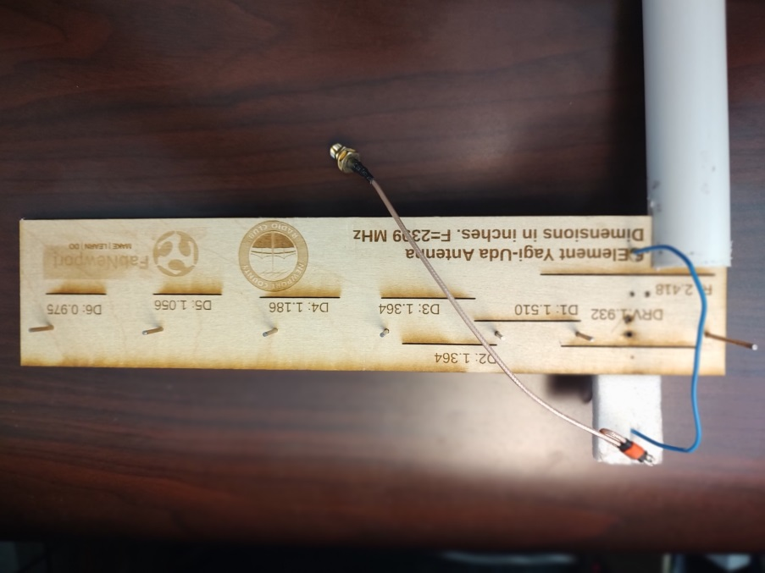
MESHING Around: ÄRTEN Workshops Continue
The ÄRTEN™ project designed and built an 8 element YAGI prototype with ¼” Plywood and a Laser cutter. Elements are common AWG 14 wire.
The plan is to cut some for a build event in September with local youth and measure them with the VNA.
Each antenna is expected to be a bit different so that the measurement results can be compared and discussed. Simple parameters like SWR and beamwidth will be attempted.

Slide 13
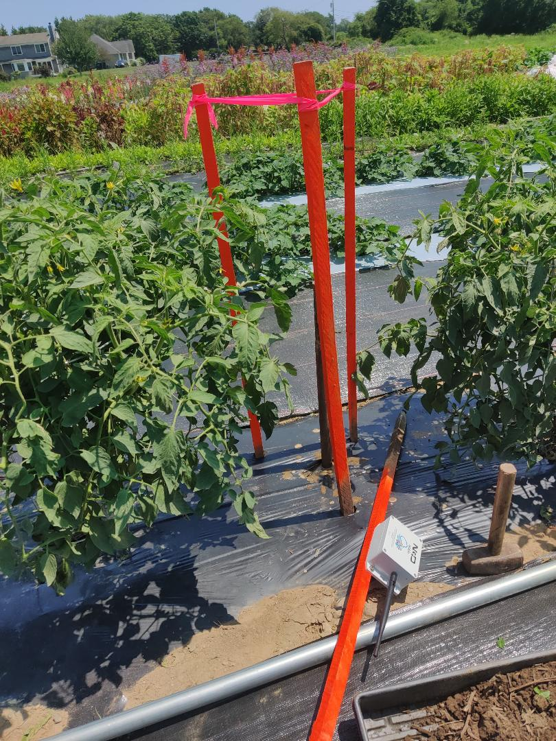
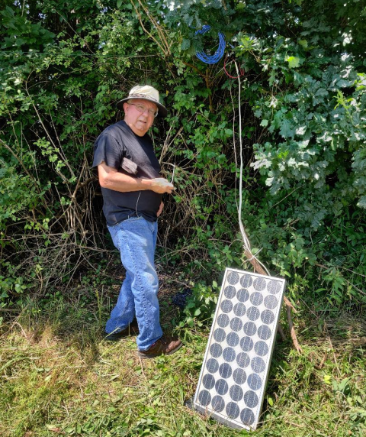
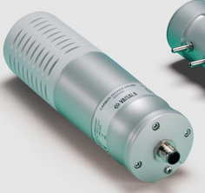
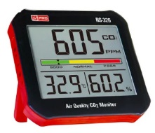
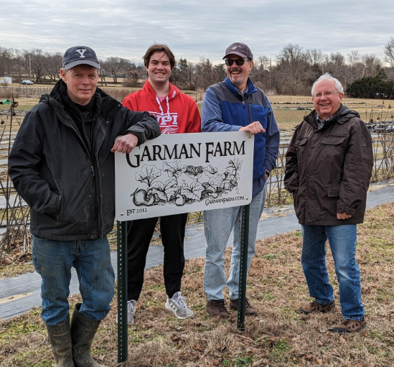
OUTSTANDING IN OUR FIELD
Initial CO₂ sensor location
Pop corn growing area
Antenna height ≈10 ft
Solar power for charging and photosynthesis calibration
CO₂ concentration and Weather data sampled day and night. APRS output
2.4 GHz AREDN Mesh node for radio and network learning
Looking for nearby relay points
https://www.vaisala.com/en/products/instruments-sensors-and-other-measurement-devices/instruments-industrial-measurements/gmp343
Repeater in a tree

Slide 14
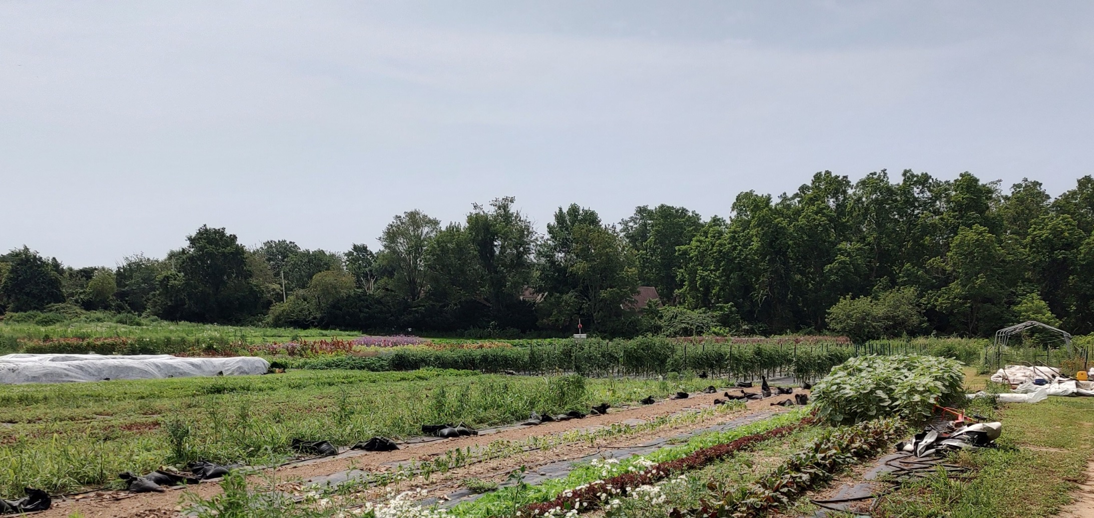
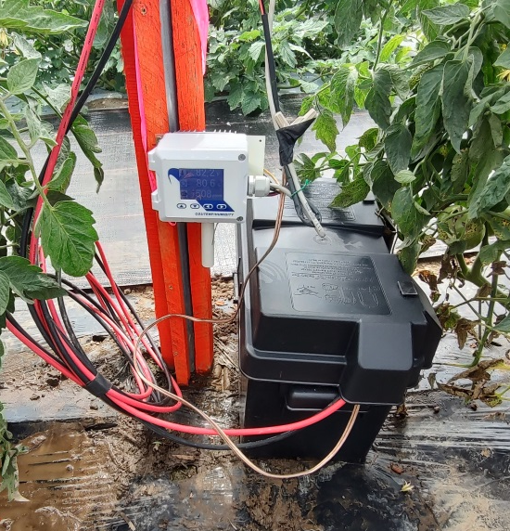
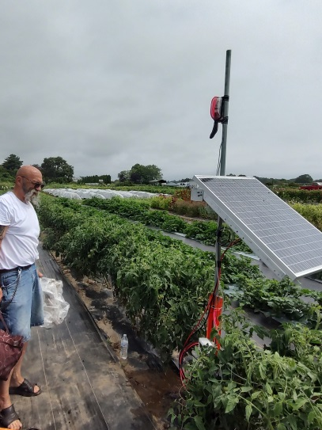
OUTSTANDING IN OUR FIELD
Tempco Sensor deployed at Garman Farm

Slide 15
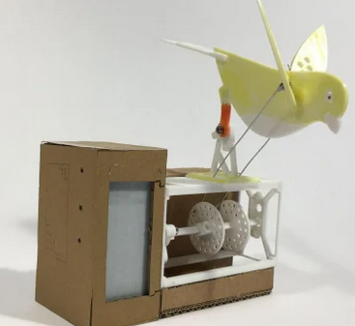
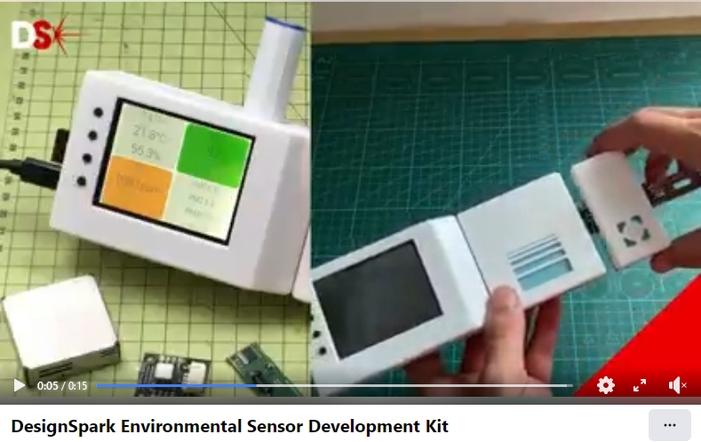
We are not alone -
https://www.rs-online.com/designspark/jude-pullen-air-quality-canary-project
https://www.rs-online.com/designspark/air-quality-and-activist-engineering-update

Slide 16
Contest Ideas
Defined awards
ARTEN DYDX - 1 yard at 1-10 GHz = 1 Mile of HF DX
Encourages short and direct connection (without a repeater)experiments with significant frequency reuse up to about 8 miles (180⁰ great circle)
Longer connections are classified as Extra Terrestrial and allow Moon-bounce, Moon QSOs, and satellite radio operation projects
Band Factor included to allow lower frequencies and make
<30MHz the same as HF DX and encourage >10 GHz
ARTEN WAN -I,V,X,L,C “Worked All Nodes” Certificates.
Participate today - CQ MESH ACTIVITY at the Show

Slide 17
FUTURE CONTEST IDEAS
ARTEN WEB “Worked Every Band” Award
ARTEN CAN “Connected to All Nodes” Award
ARTEN WAM “Worked All Modes” Award
ARTEN MEN Moon (ours) - Earth Networked
ARTEN WOMEN World (e.g. Planet) Or Moon (e.g. Europa) to Earth Networked

Slide 18
Other mesh projects - Much is happening
Western States have been deploying emergency and dense city networks for some years now. This was the impetus behind the development of the AREDN mesh software that continues to be improved.
www.arednmesh.org
World map --- http://usercontent.arednmesh.org/K/5/K5DLQ/livemap2.html#2/66.2/-67.9
ARRL NE-DIV has a working group on Spectrum Protection and Use that meets on Mesh status on alternate meetings.
https://nediv.arrl.org/spectrum-protection-utilization/#New_England_Mesh_Networking
AR|DC grants have been issued to RI (Fire Tower Sites), Maine (15 sites) and
one applied for by New Hampshire (MerrimackValleyARA.org) to build out wireless amateur radio mesh networks on 2.4 and 5.8 GHz with the larger goal of linking the New England region.
Bill Richardson, NG1P, presented at the Maine State Convention and Hamfest on Saturday March 25.
https://www.ardc.net/apply/grants/2022-grants/grant-rhode-island-emergency-mesh-network-and-digital-voice-repeater-network/

Slide 19
NEXT STEPS
If the ideas presented interest you and you want further information, send me an email at:
K1YBE@YAHOO.COM
You can follow us at www.w1sye.org (ARTEN project)
Special thanks to our ARRL Foundation Grant Collaborators:
KB1ZZU(Rob White), KC1NEK (Nancy Austin), K1NPT (Mike Cullen),
Fab Newport, and many others
Futures..
NCRC General/Extra seminars will highlight details about ARTEN tech on exams
Projects building web based HF radio control panels and sending IF I/Q digital samples from a shared remotely controlled dish antenna for decoding.
Any internet availability can be used for testing but commercial internet access($/mo) is not needed to operate locally on a HAM mesh network

