Slide 1
ÄRTEN™ project
www.w1sye.org
Amateur Radio Training Experiment Network
Experiments in the Ham bands from 1 to 10 GHz (3 to 33 cm)
I think of the SHF bands as the new “short wave radio” of this century,
HF(10m to 100m) was considered short wave when Ham radio was established
Now it’s time for 3 cm/10 GHz to 30 cm/1 GHz to be a catalyst
============================
This project includes the use of the AREDN Mesh software
An ARRL Foundation Grant of $7,975 was awarded in Dec 2022

Slide 2
ÄRTEN™ - Idea for the name
arten v. (Latin)
To compel, force, or induce (sb. to do sth.);
to induce or bring about (a result);
ärten n. (Swedish) - definite singular of ärt
The Ä umlaut (dots) is intended to represent a charge dipole radiating knowledge.
TEN - A nod to 10 GHz

Slide 3
cm Bands Available to all classes of Amateur Licensees
33 Centimeters (902-928 MHz) 13 inches
23 Centimeters (1240-1300 MHz) 9 inches
13 Centimeters (2300-2310 and 2390-2450 MHz) 5 inches
9 Centimeters (3300-3500 MHz) 3.5 inches
5 Centimeters (5650.0-5925.0 MHz) 2 inches
3 Centimeters (10000.000-10500.000 MHz ) 1.2 inches
Already established technology allows us to put them to use in novel ways
We have these radios in our homes now in low cost WiFi routers at 2.4 and 5 GHz.
WiFi frequencies can reuse the many AREDN™ equipment solutions
USE IT OR LOSE IT - continuing pressure on the FCC to reallocate spectrum

Slide 4
CONCEPTS
NCRC will plan and own an array of local mesh nodes and encourage attachment by Hams with an entry level Technician and higher class licenses.
Traffic will be open using published protocols and not encrypted except in emergencies.
TLS and other encryption protocols will be monitored and blocked in normal use.
This makes ÄRTEN an experiment in cybersecurity.
Internet connections are allowed but traffic will be monitored to avoid commercial use.
Low Cost for personal equipment will encourage youth access
Many of the components are available for less than $50 and a station can be <$100.
Most of this can be done with reprogrammed WiFi routers and home brew antennas,
The size of cm band antennas make 3D printing them a reality.
Make the learning material (youtubes and online documents) available for all.

Slide 5
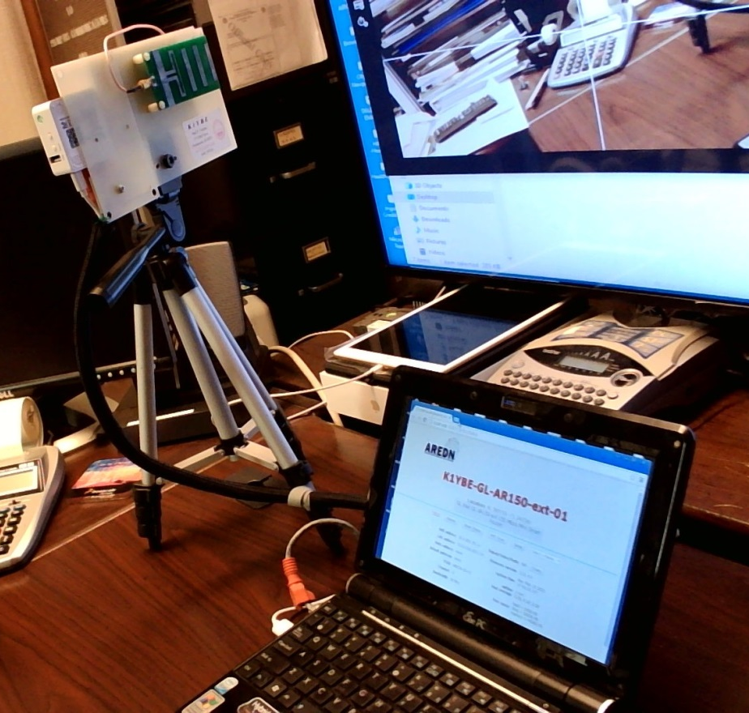
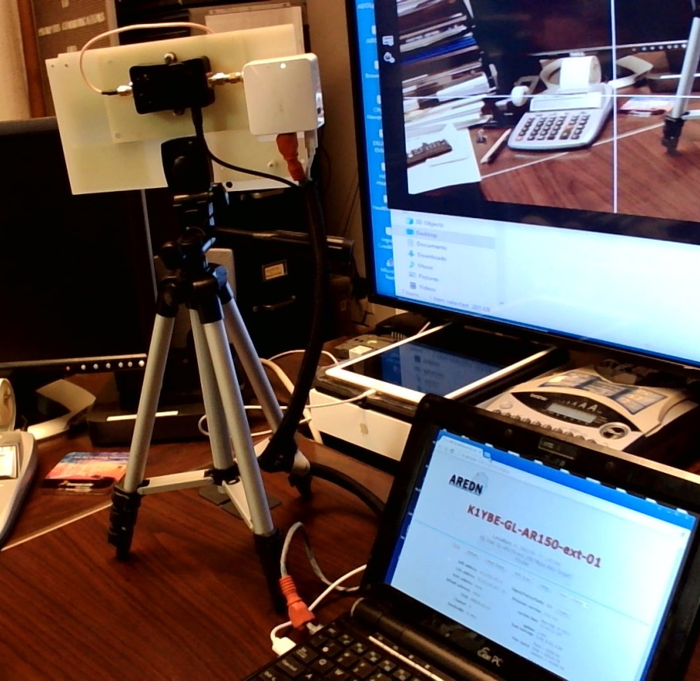
AN EXAMPLE NODE OPERATED AT 3 MILES
Equipment:
Approx. $70
Plus a computer (Raspberry PI is
adequate)
< Yagi-Uda side
Router/Radio(white) >
4 W Amp (black)
Control Web page from the router
↓

Slide 6
Current 2023 Initiatives
Access to a quality 6GHz VNA and training for RF component and antenna calibration
Workforce training for RF/ wireless / xG-NR deployments (see next slide)
Incremental exposure to radio and antenna measurement technologies.
https://nediv.arrl.org/2023/02/17/ham-radio-is-a-gateway-to-technology/
Q. When was the first time you saw and then used a VNA?
CO₂ Sensors in farm fields to collect data that illustrates the Oxygen/CO₂ life cycle.
Weather and solar irradiance data will also be collected to help understanding of the measurements
APRS reporting of CO2 concentration will be prototyped.
Data will be provided to local Middle and High schools for classroom project analysis.
Exposure to Networking
Mesh nodes allow any IP application to be used. Nodes provide complex functions like Remote Radio control as well as simple MESHCHAT
Advanced monitoring of mesh traffic can be used to demonstrate and implement cyber security techniques
QSOs by chat messaging would use CW procedures to teach these messaging skills.
Radio fun
While Mesh radio at 2397 MHz is the initial deployment for sensor data transmission, the equipment can be use to connect with nodes being deployed in many Mesh projects including the NE Mesh initiative making . CQ MESH and POTA are near term realities

Slide 7
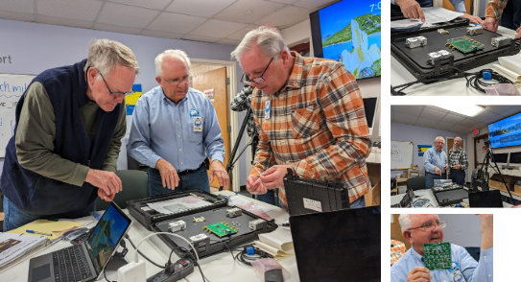
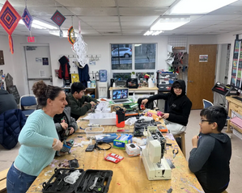
Very Nice Analyzer Initiatives
A quality 6GHz VNA was procured and 2 events at Fab Newport held
Biweekly meeting at FabNewport from 3 to 5 pm engages youth using the center ‘s concurrent STEM activities. Please visit and participate. March 20 2023
https://fabnewport.org/pull-it-apart/
NCRC recognition
https://nediv.arrl.org/2023/02/17/ham-radio-is-a-gateway-to-technology/

Slide 8
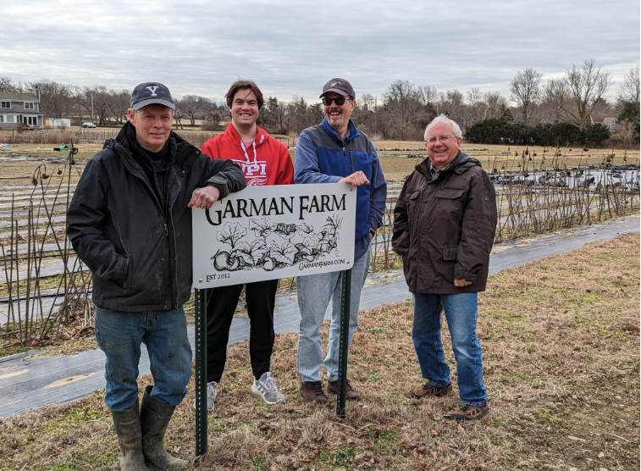
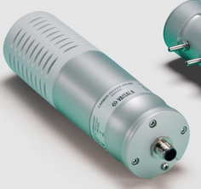
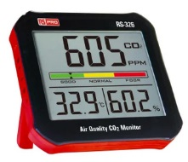
OUTSTANDING IN OUR FIELD
Initial CO₂ sensor location
Pop corn growing area
Antenna height ≈12 ft
Solar power for charging and photosynthesis calibration
CO₂ concentration and Weather data sampled day and night. APRS output
2.4 GHz AREDN Mesh node for radio and network learning
Looking for nearby relay points
https://www.vaisala.com/en/products/instruments-sensors-and-other-measurement-devices/instruments-industrial-measurements/gmp343

Slide 9
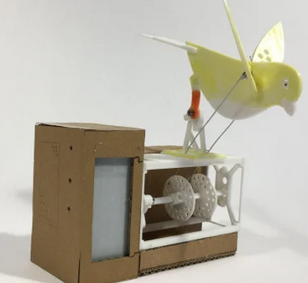
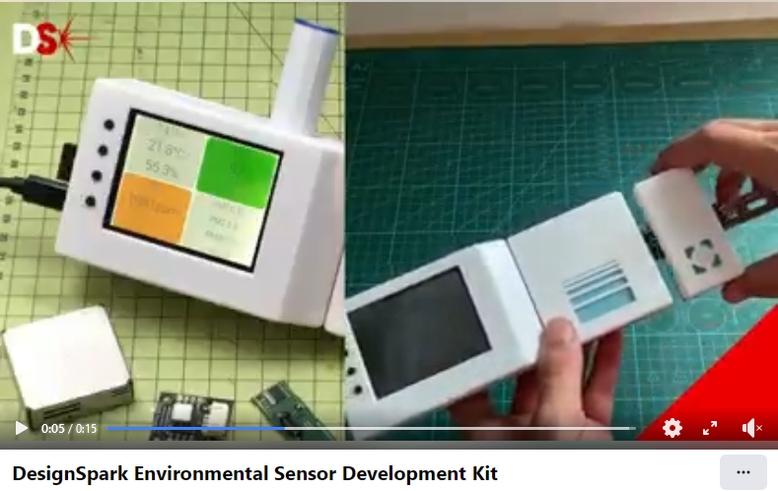
We are not alone -
https://www.rs-online.com/designspark/jude-pullen-air-quality-canary-project
https://www.rs-online.com/designspark/air-quality-and-activist-engineering-update

Slide 10
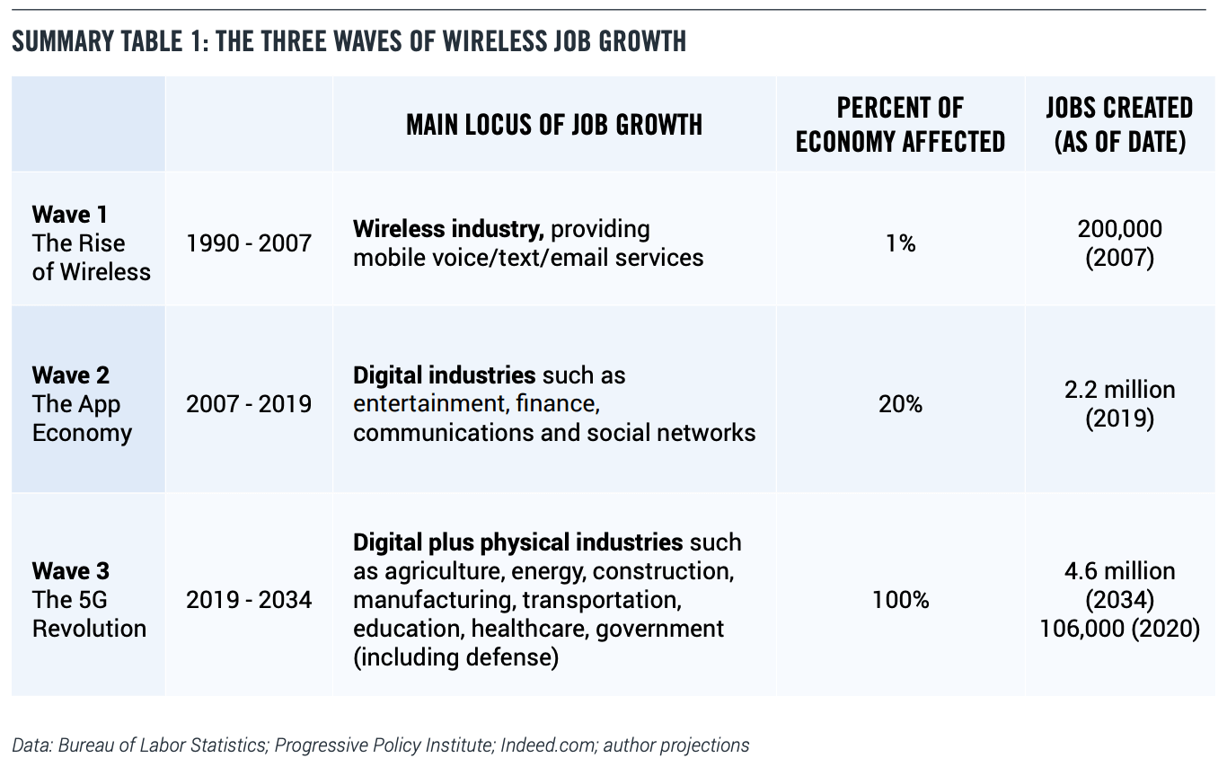
Projected Job Growth - 5G

Slide 11
Other mesh projects - Much is happening
Western States have been deploying emergency and dense city networks for some years now. This was the impetus behind the development of the AREDN mesh software
www.arednmesh.org
ARRL NE-DIV has a working group on Spectrum Protection and Use that meets on Mesh status on alternate meetings.
https://nediv.arrl.org/spectrum-protection-utilization/#New_England_Mesh_Networking
AR|DC grants have been issued to RI (Fire Tower Sites) and Maine (15 sites) to build out wireless amateur radio mesh networks on 2.4 and 5.8 GHz with the larger goal of linking the New England region
Bill Richardson, NG1P, presented at the Maine State Convention and Hamfest on Saturday March 25.
https://www.ardc.net/apply/grants/2022-grants/grant-rhode-island-emergency-mesh-network-and-digital-voice-repeater-network/

Slide 12
Contest Ideas
Defined awards
ARTEN DYDX - 1 yard at 1-10 GHz = 1 Mile of HF DX
-Encourages short and direct connection (without a repeater)experiments with significant frequency reuse up to about 8 miles (180⁰ great circle)
-Longer connections are classified as Extra Terrestrial and allow Moon-bounce, Moon QSOs, and satellite radio operation projects
ARTEN WAN -I,V,X,L,C “Worked All Nodes” Certificates

Slide 13
FUTURE CONTEST IDEAS
ARTEN WEB “Worked Every Band” Award
ARTEN CAN “Connected to All Nodes” Award
ARTEN WAM “Worked All Modes” Award
ARTEN MEN Moon (ours) - Earth Networked
ARTEN WOMEN World (e.g. Planet) Or Moon (e.g. Europa) to Earth Networked

Slide 14
NEXT STEPS
If the ideas presented interest you and you want further information, send me an email at:
K1YBE@YAHOO.COM
You can follow us at www.w1sye.org
Futures..
The NCRC General/Extra seminar will highlight details about ARTEN tech as they are already on the license exams.
Projects building web based HF radio control panels,
Sending IF I/Q digital samples from a shared remotely controlled dish antenna for local decoding by several operators.
Any internet availability can be used for testing but commercial internet access($/mo) is not needed to operate locally on a HAM mesh network

