Slide 1
Why Repeaters?
Repeaters enable communication between 2 or more radio stations that cannot communicate directly point-to-point.

Slide 2
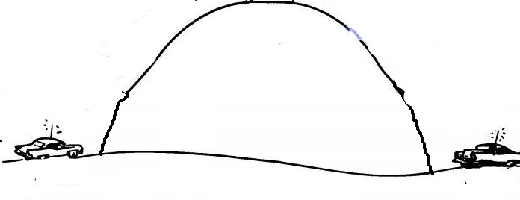
A radio communication problem in Mayberry
Mayberry
Mountain
Sheriff
Andy
Deputy
Fife

Slide 3
Motorola to the rescue
Motorola had a strong presence in the 2-way land mobile radio (LMR) business in the 1960’s. Motorola had been putting radios in automobiles since the 1930’s.
The Motorola Receiver-Transmitter station (repeater) was a natural evolution in their LMR product line.

Slide 4
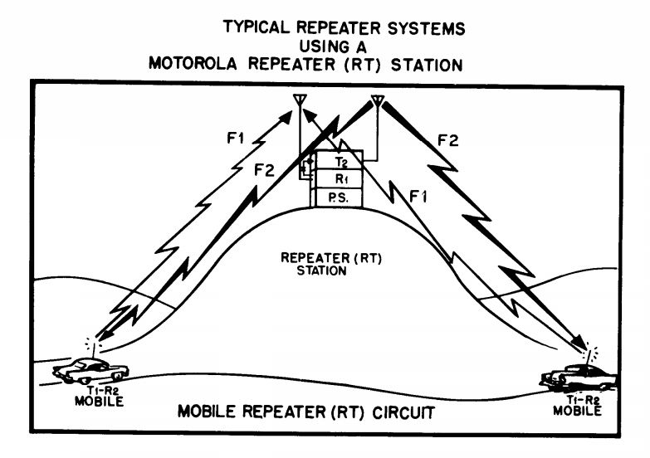
Receiver
Transmitter

Slide 5
Split Frequency Operation
Repeaters necessarily must transmit and receive on different frequencies. The frequency difference is called ‘split’ or ‘offset.’
The repeater’s receiver listens on the Input Frequency.
The repeater’s transmitter transmits on the Output Frequency.
The receive frequency can be higher or lower than the transmit frequency. Determined by repeater coordinating bodies.
Common Amateur repeater splits:
  2m – 600 KHz
  440 MHz – 5 MHz

Slide 6

Bare Bones Repeater
Audio
Control
“Busy”
PTT
Receiver
Transmitter

Slide 7

Typical Repeater
RX Audio
TX Audio
COR
Control
CTCSS
PTT
Receiver
Controller
Transmitter
COR = ‘Carrier Operated Relay’ Historical term – same as ‘busy light’
CTCSS = Continuous Tone Coded Squelch System – Motorola ‘PL’

Slide 8

Why CTCSS?
Reduces interference between adjacent repeater systems sharing same frequency
150 MHz
CTCSS
100 Hz
150 MHz
CTCSS
67 Hz
Sheriff Andy
150 MHz
CTCSS
100 Hz
Mayberry Repeater
Podunk Repeater

Slide 9
CTCSS
Continuous Tone Coded Squelch System
Invented by – who else – Motorola in the 1950’s
38 EIA Standard tones – 67.0 through 250.3 Hz
Sometimes incorrectly called “sub audible” tone
Not audible because receivers filter CTCSS tones out of speaker audio with a high pass audio filter
CTCSS decoders take finite time to decode CTCSS. This causes a delay when keying up a repeater using CTCSS. PTT!
Lower frequency tones require longer decode times

Slide 10
Basic Controller Functions
Insert Voice and/or CW Identification - FCC
Provide TX hang time after input signal drops (tail)
Insert Courtesy Beep
Provide Time-Out Timer (TOT) - FCC
  Timer resets after Courtesy Beep
Provide Repeater Control (On – Off, other functions) - FCC
Control Methods:
  On-channel DTMF
  Secondary Receiver DTMF
  Telephone line
  Internet

Slide 11
Viable Repeater?
RX Audio
TX Audio
BaofengUV-5R
COR
BaofengUV-5R
Control
CTCSS
Receiver
Controller
Transmitter
Can we slap two Baofeng handie-talkies together with a controller to make a repeater?
Yes, sort of. People have actually done this to build low cost portable field-deployable emergency repeaters.

Slide 12
Repeater Hardware Requirements
Repeater service is much different than station service, imposing additional requirements on system hardware
Hardware that normally functions flawlessly in station service can fail or seriously degrade the performance of a repeater system
Very high duty cycle – plan for 24/7 continuous duty cycle
Climate control may be non-existent in some repeater vaults. All equipment must be rated for extreme environments.
Duplex operation presents unique challenges from incidental passive intermodulation (PIM)

Slide 13
Repeater Hardware Requirements
Transmitters
  Very low audio distortion
  Good audio frequency response
  Very clean RF output – low sideband noise
  Rated for 24/7 continuous duty cycle
Receivers
  Very low audio distortion
  Good audio frequency response
  Very tight RF front end selectivity
  Very high desense threshold
  Very high intermod rejection
Power Supplies
  Very low conducted and radiated RFI
  High spike and line disturbance survivability
  Rated for 24/7 full load continuous duty

Slide 14
Repeater Hardware Requirements
Transmission Lines
  Excellent shielding – very low signal ingress/egress
  Single shield braided cables are inadequate
  Very low PIM
  Most braided coax cable generates unacceptable PIM
  ‘LMR’ and LMR clones are the worst PIM generators
  All bare copper braid cables generate PIM
  Andrew Heliax is the gold standard
Connectors
  No magnetic metals (including nickel plate)
  Connector bodies should be brass
  Silver or tri-metal (Cu-Sn-Zn) plating
  Andrew connectors are the gold standard
Antennas
  Low VSWR across repeater split
  Very low PIM
  Most Amateur antennas generate unacceptable PIM
  Commercial fiberglass antennas can develop PIM

Slide 15
Separate TX and RX Antennas
RX Audio
TX Audio
COR
CTCSS
Control
PTT
Receiver
Controller
Transmitter

Slide 16
Common Antenna
Duplexer
RX Audio
TX Audio
COR
CTCSS
Control
PTT
Receiver
Controller
Transmitter

Slide 17
Transmitter - Receiver Isolation Requirements
Transmitter energy must flow only to TX antenna – must not reach receiver
Transmitter energy includes:
  On-TX-channel energy (TX main signal)
    Causes receiver desense
  On-RX-channel energy (TX sideband noise)
    Causes on-channel receive interference
Receive signal energy from RX antenna must flow only to receiver
  Prevents receive signal energy from being split between receiver and transmitter
  Not a problem with separate antennas

Slide 18
Sidebar Discussion – Receiver Desense
Receiver desense is caused by a strong off-channel signal
One or more receiver circuits is overloaded to the point that the DC operating point of the circuit changes, upsetting the operation of that circuit
Receive degradation caused by on-channel sources (such as transmitter noise) is not desense
The cure for receiver desense is very high selectivity ahead of any active stages in the receiver (tight front end)
Very high front end selectivity is difficult to achieve in a frequency-agile receiver

Slide 19
TX-RX Isolation Requirements – W1SYE MASTR II Repeater
67 dB
Receiver Desense
Transmitter noise
57 dB

Slide 22
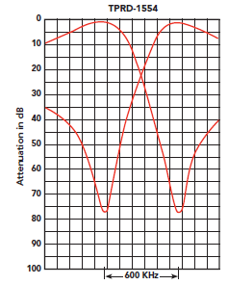
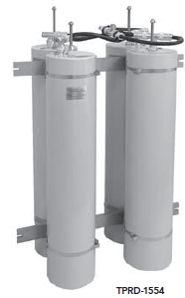
ELECTRICAL SPECIFICATIONS TPRD-1554
Tuning range 144-174 MHz
Frequency separation (min) 600 KHz
Maximum input power 350 watts
VSWR (max) 1.5:1
Insertion loss: TX/RX to ant. 1.5 dB
RX isolation at TX frequency 77 dB at 600 KHz
TX noise suppression at RX frequency 77 dB at 600 KHz
Temperature range -30°C to +70°C
Cavities (4) 5”
Receive side
Transmit side

Slide 23
Duplexers
Made up of multiple coaxial resonator sections. Colloquially called cavity filters, but technically they are not cavity filters. They are actually quarter-wave coaxial stub filters.
These are very sharp filters due to their extremely high Q – typical Q’s are on the order of 3,000 or more. This high Q is achieved by making very low loss coax from large diameter inner and outer conductors with silver plating on all surfaces.
Three types of coaxial resonator:
  Bandpass
  Band Reject
  Bandpass – Band Reject (Bp-Br) - Most common in duplexers

Slide 24
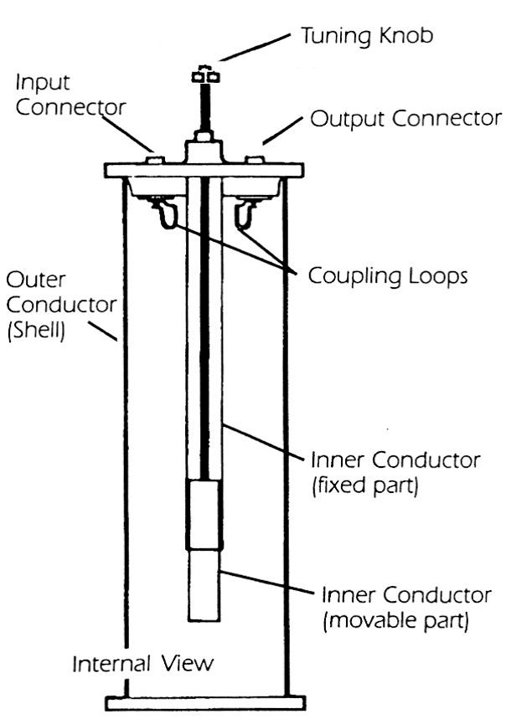
Bandpass Filter Construction

Slide 25
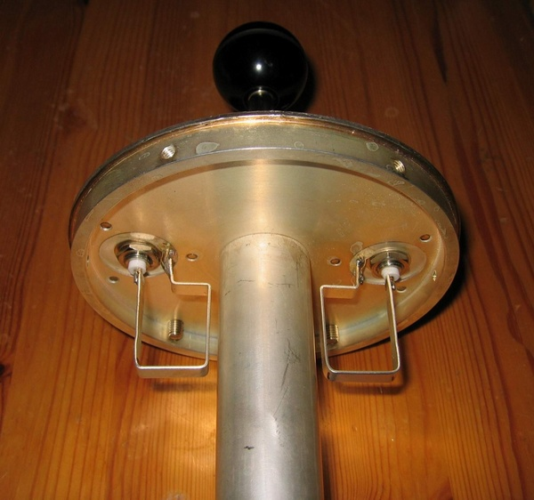
Bandpass Filter Coupling Loops

Slide 26
Bandpass Filter Construction
The pass frequency is adjustable by mechanically adjusting the length of the inner conductor by means of a trombone section driven by a threaded rod. The threaded rod is made of a special metal (Invar) to minimize the mechanical effects of temperature changes.
Coupling loops inject and extract RF energy from the coaxial line. This coupling is electromagnetic. The degree of coupling can be made adjustable by making the loops rotatable. Lighter coupling provides sharper filter response at the expense of more insertion loss.

Slide 27
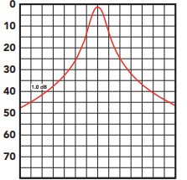
Bandpass Filter Response

Slide 28
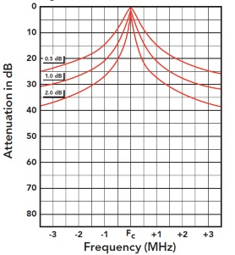
Effect of Varying Loop Coupling

Slide 29
Bandpass - Band Reject (Bp-Br) Filter Construction
A filter coupling loop can be made into a series-resonant circuit by the addition of a capacitor in series with the loop. At the resonant frequency the loop becomes a dead short. This introduces a notch in the filter response at the loop’s resonant frequency. The loop’s notch frequency is tuned to the filter’s opposite split frequency. A single loop is used to couple RF energy in and out of a Bp-Br coaxial resonator.
A Bp-Br filter has a tunable Pass Frequency (rod adjustment) and tunable Reject Frequency (capacitor adjustment.) This property of the Br-Br filter is very desirable for duplexer use.
No free lunch. The sharp pass frequency response curve of the bandpass filter is ‘flattened out’ by the introduction of the tuned loop. This may be a detriment in a densely RF-populated site.

Slide 30
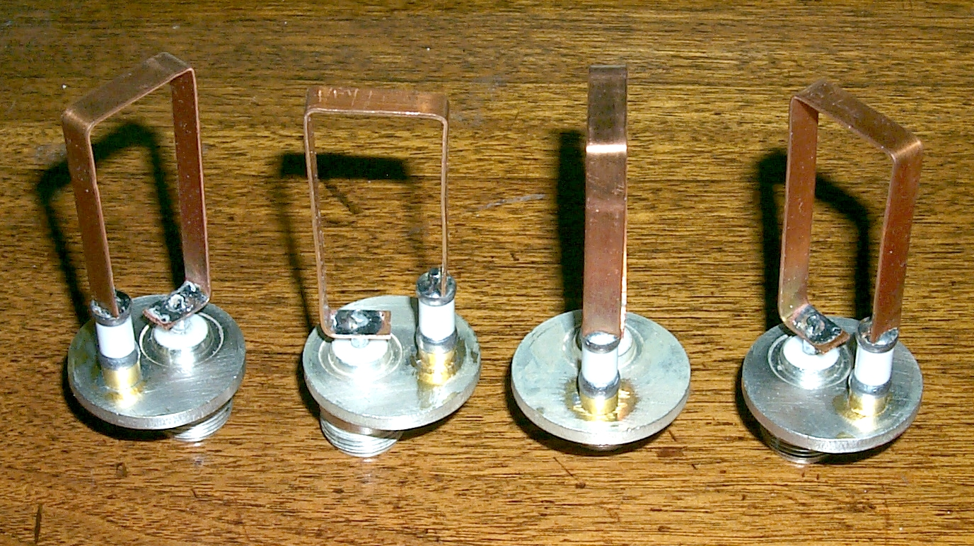
Bp-Br Coupling Loops

Slide 31
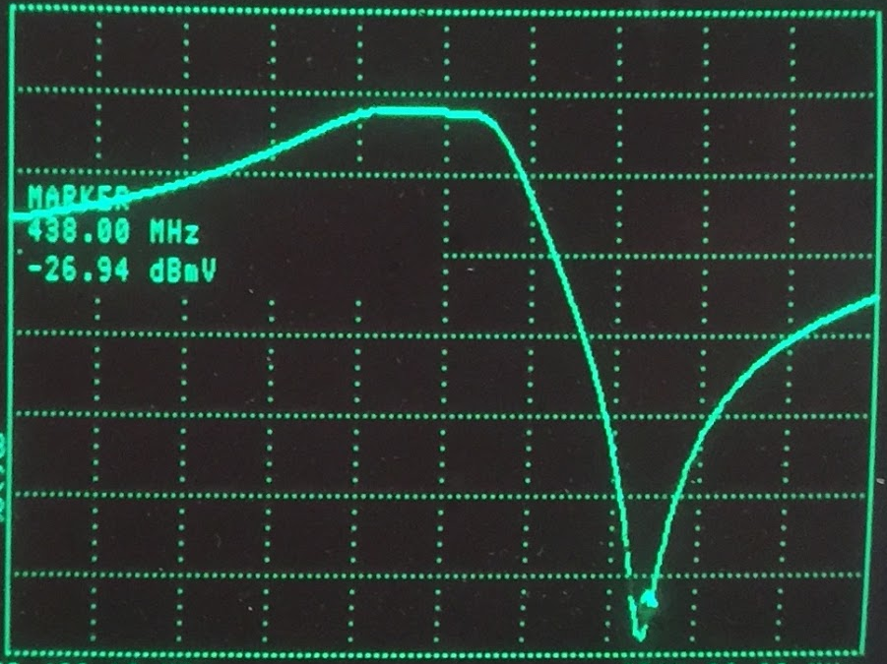
Bp-Br Filter Response

Slide 32
Comparing Response of Bandpass and Bp-Br Filters
Better out-of-band signal rejection
Deeper notch at split frequency

Slide 33
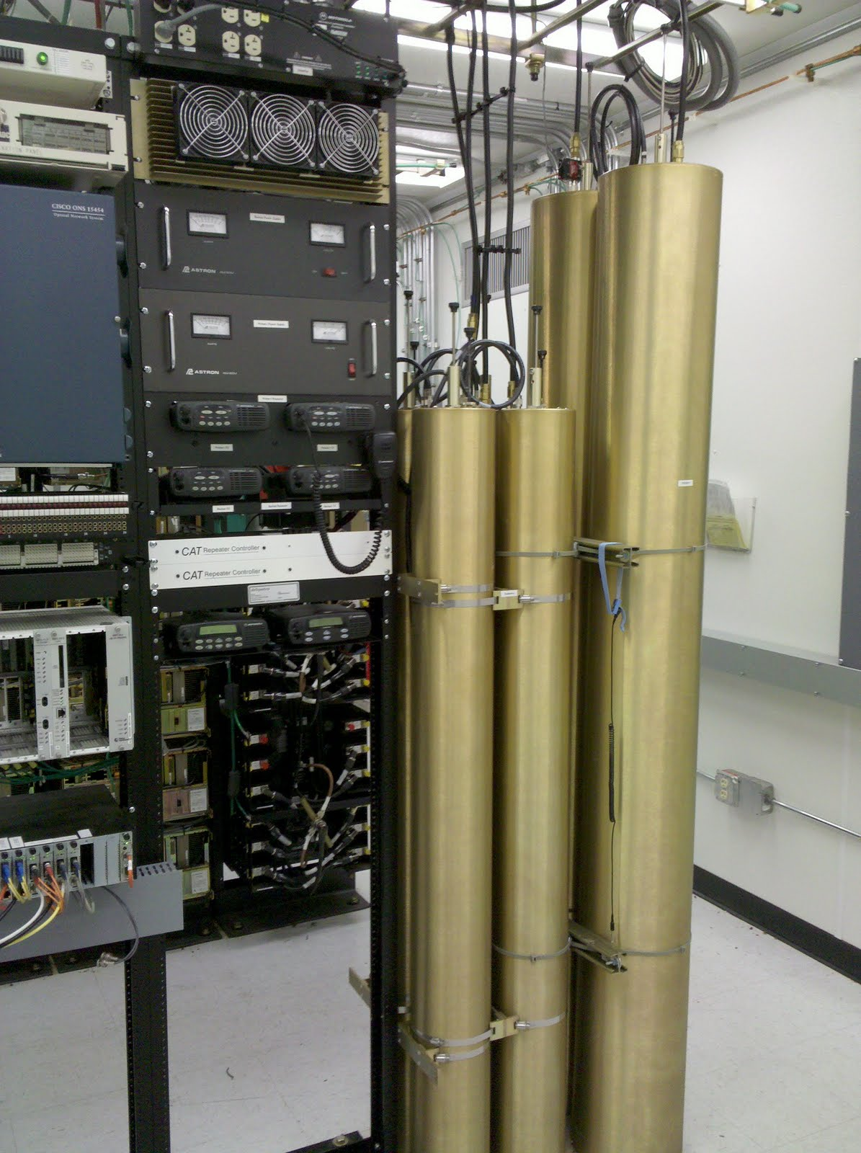

Slide 34
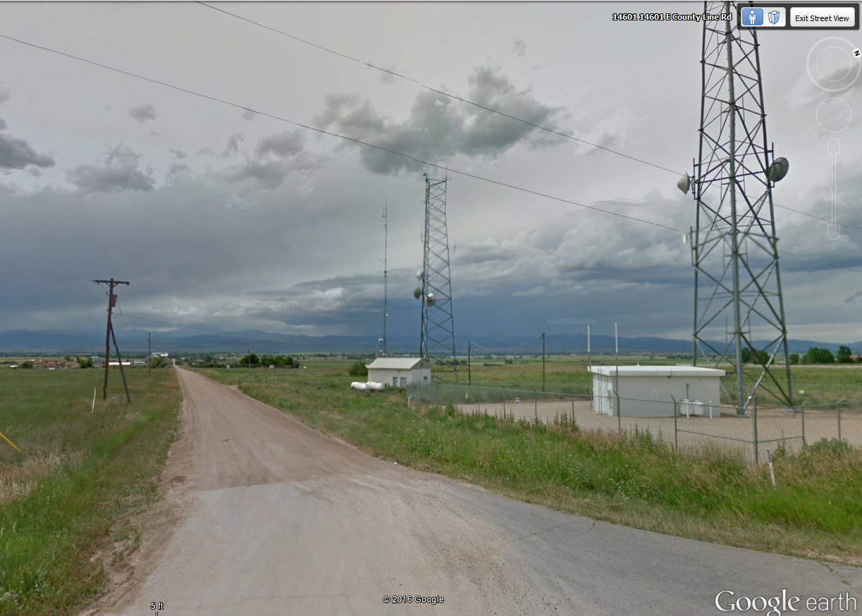
Original Home of the W1SYE MASTR II

Slide 35
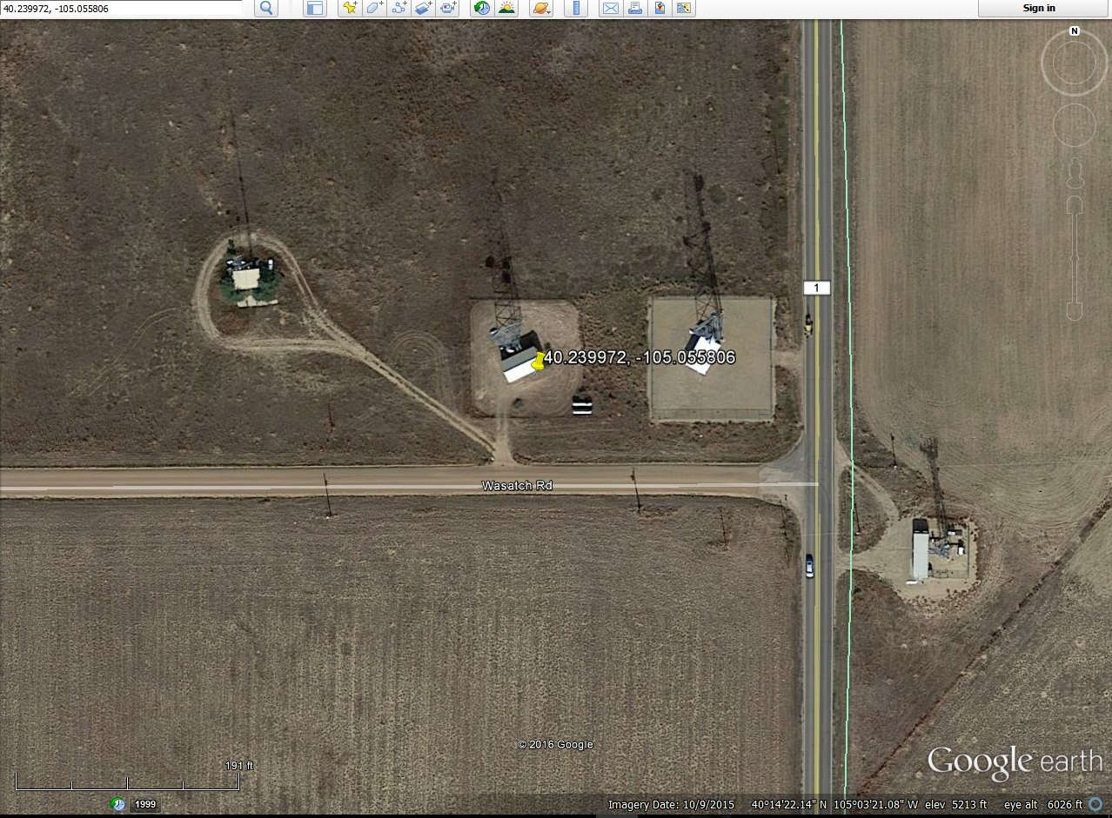

Slide 36
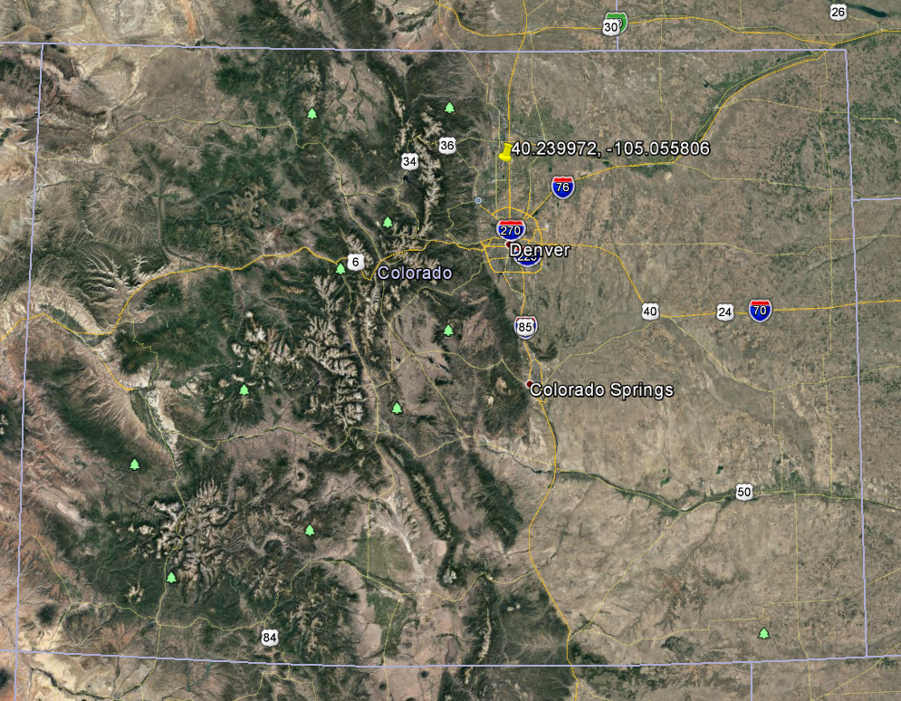

Slide 37
