Slide 1
QSL Highlights W1SYE
Newport County Radio Club
QSL Manager N1CKT
Chuck.Kesson@gmail.com

Slide 2
QSL Activity
KA1ZOU passed QSL baton to N1CKT on 29 Dec
K1JSM set up W1SYE for LoTW
N1CKT uploaded 2,369 records from 2014 & 2015 – 11 control ops
WB4SON uploaded 581 records GOTA-FD 2015
Activators met on 8 Jan
QSL approach mentioned during club meeting 11 Jan
N1PSX and KC1ARO permission to use W1SYE WFD 30-31 Jan
789 records uploaded – 9 control operators
W1LY and WB4SON worked DXCC Feb-Mar
216 records uploaded

Slide 3
QSL Approach
Ask trustee to use call sign
Who, what, when and where
Log all contacts
Any computer and logging software
Station call and QTH
YYYYMMDD/#### UTC
Band/frequency/mode
Control operator
Error checking
Share ADIF file with QSL manager
Import ADIF file to club master Amateur Contact Log >> N3FJP
Upload records to LoTW >> errors 3.04x10^-03

Slide 4
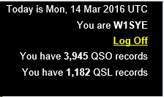
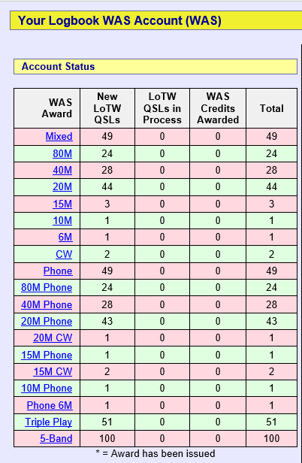
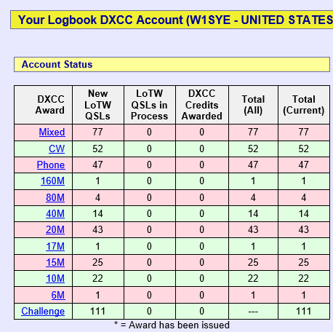
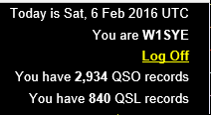
W1SYE Status

Slide 5
QSL Goals
Encourage participation
Roger Williams islands >> the hard ones
ARRL Field Day – June 25-26 >> arrl.org/field-day
Lighthouses and lightships – August >> ILLW.net
Jamboree On The Air – October 16-18 >> scouting.org/jota
Islands On The Air – IOTA >> rsgbiota.org
US Islands >> usislands.org
National Parks On The Air >> arrl.org/NPOTA
Work all 50 states
DXCC – 100 countries

